Slide 1


INNOVATOR HUZSAM
LEARN. EVOLVE. INNOVATE.
Building the next evolution of learning.
LIVE TRAINING → SKILLPATH + K–12 → AI TUTOR
MUHAMMAD HUZAIFAH SAHMI • FOUNDER & CEO

Slide 2
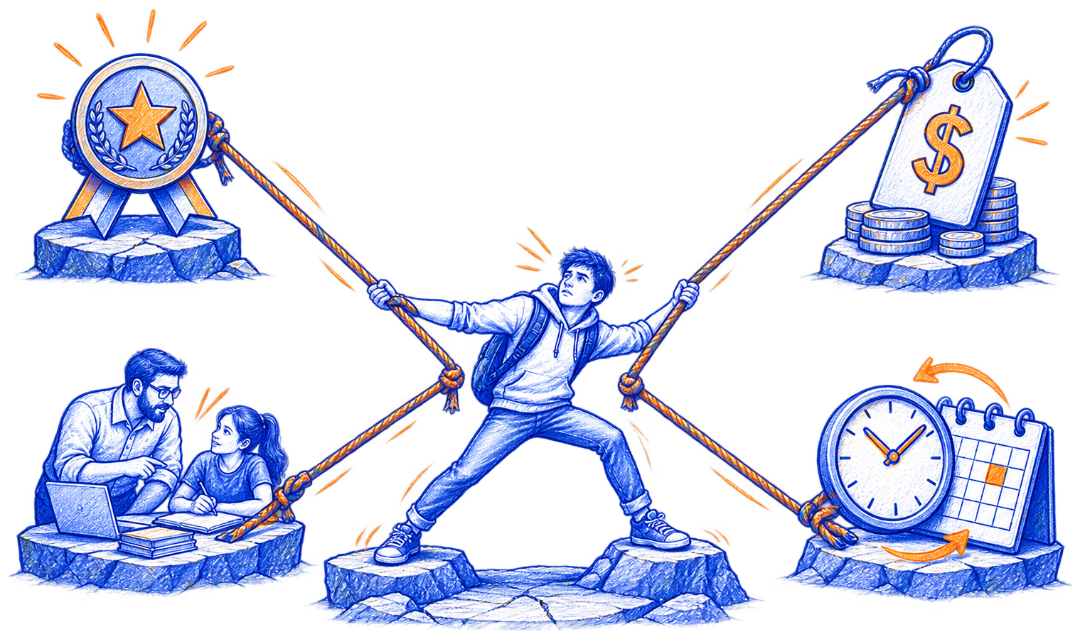
PROBLEM
Learners are forced to choose what to sacrifice.
QUALITY
AFFORDABILITY
PERSONALIZATION
FLEXIBILITY
THE GAP: QUALITY + AFFORDABILITY + PERSONALIZATION + FLEXIBILITY

Slide 3

OUR SOLUTION
Validated today. Built to scale tomorrow.
1: LIVE TRAINING
2: SKILLPATH + K–12
3: AI TUTOR
VALIDATED
AI-POWERED • LAUNCHING IN 3 MONTHS
TEXT + VOICE

Slide 4

MARKET OPPORTUNITY
$353B
TAM
GLOBAL E-LEARNING • 2025
$104.2B
SAM
ASIA-PACIFIC • 2025
$1M+
IHS TARGET
ANNUAL REVENUE • 2031
Source: Grand View Research
Notes:
[Sources]
- Grand View Research, E-learning Services Market Size & Share Report, 2026–2033: https://www.grandviewresearch.com/industry-analysis/e-learning-services-market (accessed 2026-08-12). Supports USD 353.0B global e-learning services revenue in 2025 and 19.9% CAGR for 2026–2033.
- Grand View Research, Asia Pacific E-learning Services Market Size & Outlook, 2033: https://www.grandviewresearch.com/horizon/outlook/e-learning-services-market/asia-pacific (accessed 2026-08-12). Supports USD 104.1525B Asia-Pacific revenue in 2025 and 22.1% CAGR for 2026–2033.
- IHS management target supplied by the user: USD 1M+ annual revenue by 2031.

Slide 5

TRACTION
The first model is no longer a hypothesis.
$25K+
150+
REVENUE
ACTIVE
SUBSCRIPTIONS
350+
10+
CLIENTS
COUNTRIES
16 MONTHS
SECP + FBR
REGISTERED
~$20 CAC → ~$100 LTV
~5:1 LTV:CAC
COMMERCIAL PROOF IS IN PLACE BEFORE THE NEXT PRODUCT LAYER
Notes:
[Sources]
- IHS management metrics supplied by the founder, current as of August 2026: USD 25K+ cumulative revenue in 16 months; 350+ clients served; 150+ active subscriptions; 10+ countries served; SECP + FBR registered.
- IHS management unit economics supplied/converted to rounded USD equivalents for this pitch deck: approximately USD 18 CAC, approximately USD 105 LTV and approximately 6:1 LTV:CAC.
- These are company-reported operating metrics and should be reconciled to the latest finance and subscription records before external circulation.

Slide 6

MEDIA STRATEGY
EDUCATIONAL CONTENT
PAID DISTRIBUTION
AUTOMATED FREE TRIAL
ENROLL → PROGRESS → RETAIN → REFER
Notes:
[Sources]
- IHS operating strategy and funnel details supplied by the founder: educational content, paid Meta distribution, automated direct trial booking, human-led live trials, enrollment, progress-led retention and referrals.
- Company-provided channel context used for messaging: owned educational media is intended to reduce dependence on paid acquisition over time; content is designed for multilingual/global audiences.
- No externally sourced numerical claims are displayed on these slides.

Slide 7

OPERATING PLATFORM
One platform manages every learner journey.
ADMIN • CSR • OPERATIONS • TRAINER • STUDENT
CLIENTS • SESSIONS • PAYMENTS • FOLLOW-UPS • DASHBOARDS
THE BUSINESS IS OPERATING ON ITS OWN DIGITAL INFRASTRUCTURE
Notes:
[Sources]
- IHS operating-platform capabilities and workflow details supplied by the founder: role-based Admin, CSR, Operations Manager, Trainer and Student access; clients, sessions, payments, expenses and follow-ups; dashboards and performance tracking.
- IHS product roadmap supplied by the founder: the live operating platform is the foundation for SkillPath automatic AI-powered training, K–12 and the future text-and-voice AI Tutor.
- Company-reported product status; confirm the latest production feature availability before external circulation.

Slide 8
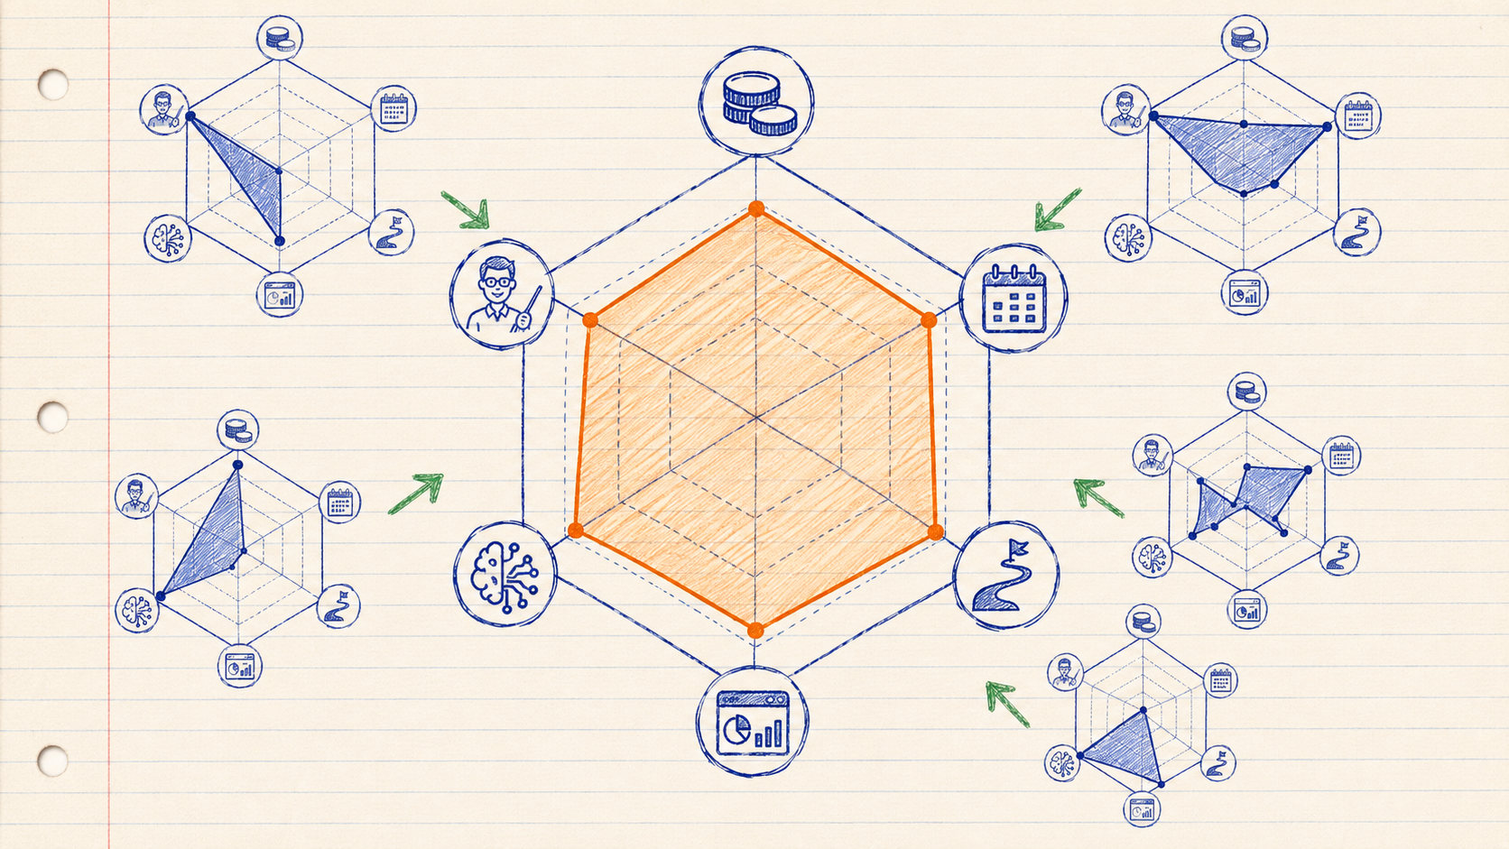
COMPETITION & EDGE
Every alternative leaves a critical gap.
Competitors typically solve one dimension - IHS combines the strongest attributes in one connected experience.
AFFORDABILITY
REAL INSTRUCTOR
FLEXIBILITY
STRUCTURED PATH
PROGRESS DATA
AI ASSISTANCE
Personalization
Notes:
[Sources]
- IHS positioning and differentiation supplied by the founder: affordable one-to-one and small-group live learning; real instructors; flexible scheduling; structured programs and milestones; progress visibility; digital delivery; live operating platform; SkillPath automatic AI-powered training; K–12; future text-and-voice AI Tutor.
- Competitor categories are qualitative archetypes for strategic comparison: traditional physical institutes, premium tutors, static MOOCs/course libraries, tutor marketplaces, and generic AI tools.
- All comparison views are company-authored strategic illustrations, not third-party market benchmarks, audited competitor scorecards, or claims about specific named companies.

Slide 9




THE TEAM
The team covers every execution layer.
MUHAMMAD HUZAIFAH SAHMI
SYEDA ARIFA RIZVI
SYED MUHAMMAD SALEH
MARYAM JAWAD
FOUNDER & CEO
COO • OPERATIONS
CTO • TECHNOLOGY
MEDIA LEAD
$25K revenue
16 months
Service delivery
& coordination
Platform build
& automation
Content engine
& growth
20+ EXPERT TRAINERS • MULTI-FUNCTIONAL REMOTE TEAM
Notes:
[Sources]
- Team names, roles and portraits supplied by the founder in the uploaded slide “10.png”: Muhammad Huzaifah Sahmi — Founder & CEO; Syeda Arifa Rizvi — COO, Operations & Service Delivery; Syed Muhammad Saleh — CTO, Platform & Technology; Maryam Jawad — Media Lead, Content & Growth.
- Company-reported proof points supplied by the founder: approximately US$25K cumulative revenue in 16 months and a wider network of 20+ expert trainers.
- Team structure is an investor-facing company-authored view. Confirm current titles, headcount and metrics before external circulation.

Slide 10
THE ASK
RAISING • US$15K
UNLOCKS
40%
PRODUCT & ENGINEERING
→
SKILLPATH + K–12
25%
GROWTH & ACQUISITION
↗
LEARNER ANALYTICS
20%
CURRICULUM & MEDIA FUNNEL
AI
AI-ASSISTED PRACTICE
10%
OPERATIONS & TRAINER ENABLEMENT
◎
REPEATABLE ACQUISITION
5%
LEGAL, COMPLIANCE & RESERVE
TARGET LAUNCH • 3 MONTHS
THE RAISE FUNDS PRODUCT EXPANSION - NOT BASIC VALIDATION
Notes:
[Sources]
- Raise amount and allocation supplied by the founder and reference slide: earlier PKR 4M ask, presented here as a rounded US$15K investor-facing ask; 40% product & engineering, 25% growth & acquisition, 20% curriculum & AI content, 10% operations & trainer enablement, 5% legal, compliance & reserve.
- Product roadmap supplied by the founder: validated Live Training model; SkillPath automatic AI-powered training and K–12 planned for launch within three months; future text-and-voice AI Tutor.
- Outcomes and milestones are company plans, not guarantees. Confirm the final financing instrument, exact USD ask and current launch dates before external circulation.

Slide 11
FINANCIAL OUTLOOK
A clear path to US$1M+ in annual revenue.
2031 • $1M+
ANNUAL REVENUE TARGET
$600K
$300K
VALIDATED
$125K
MANAGEMENT TARGETS
$50K
FY 2026–27
FY 2027–28
FY 2028–29
FY 2029–30
FY 2030–31
RECURRING PRODUCTS TURN LINEAR DELIVERY INTO SCALABLE GROWTH
Notes:
[Sources]
- Management target supplied by the founder: US$1M+ in annual revenue by 2031.
- Illustrative annual management-target path prepared for this investor presentation: US$50K (FY 2026–27), US$125K (FY 2027–28), US$300K (FY 2028–29), US$600K (FY 2029–30), and US$1M+ (FY 2030–31).
- Product roadmap supplied by the founder: validated Live Training; SkillPath automatic AI-powered training and K–12 planned for launch within three months; future text-and-voice AI Tutor; institutional and white-label opportunities longer term.
- All forward figures are company management targets, not audited forecasts or guaranteed outcomes. Confirm the latest operating plan before external circulation.

Slide 12
ROI & VALUATION PROJECTION
Targeted recovery in 24 months. Equity continues.
24
EQUITY CONTINUES
US$1M
MONTHS
BY 2030
TARGETED US$15K
CAPITAL RECOVERY
EXPECTED COMPANY
VALUATION
MANAGEMENT PROJECTION
PAYBACK TARGETS THE PRINCIPAL; EQUITY PRESERVES LONG-TERM UPSIDE
Notes:
[Sources]
- Founder-supplied management projection: US$15,000 investment targeted to be recovered through profit payouts within 24 months.
- Founder-supplied management projection: company valuation expected to reach US$1,000,000 by 2030.
- Investor retains equity ownership after the targeted capital recovery, subject to final executed investment documents.
- Profit payouts depend on distributable profit, cash availability, applicable law, board approvals, and the final investment agreement. The 24-month recovery period and 2030 valuation are management targets, not guaranteed returns, liquidity, or independently verified forecasts.

Slide 13
WE BELIEVE
•
Access to education is a fundamental human right.
•
Quality should not depend on geography.
•
Personalization should not be a luxury.
•
Technology should make learning more human.
If you believe it too, let’s build it together.
Learn. Evolve. Innovate.
JOIN US
innovatorhuzsam.com • info@innovatorhuzsam.com • +92 321 7975367
Notes:
[Sources]
- Innovator HuzSam 2D and 3D logos supplied by the founder.
- Company name, tagline, website, email address, WhatsApp number, and closing invitation supplied by the founder and the reference slide.
- Closing proposition reflects the founder-supplied company mission and pitch-deck narrative: affordable, personalized, globally accessible learning.

